Slide 1




Stop-Motion Movie Studio
Year 1 and Year 2 · Lights, Camera, Move!
Notes:
Lesson 1 and 2 title slide. Welcome the pupils to the film studio.

Slide 2
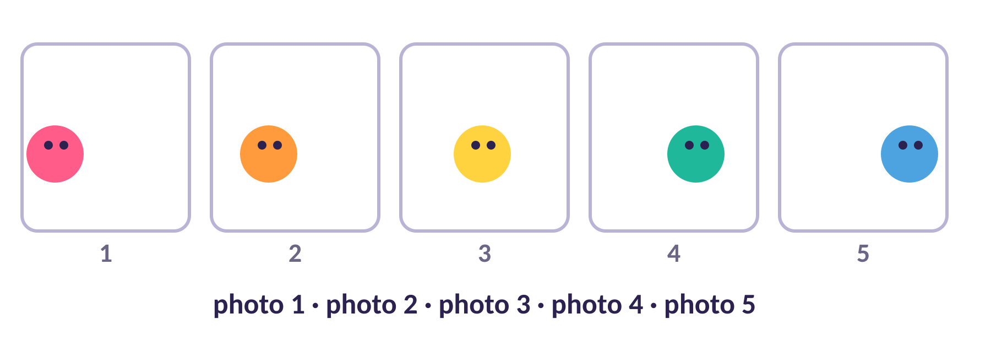
Can a pencil move by itself?
Watch the tablet very carefully…
Notes:
5 min. Before the lesson, take 8 photos of a pencil sliding across a desk a little each time (or a drawing growing on a whiteboard). Play them quickly on the tablet. Ask: How did the pencil move by itself? Take guesses.

Slide 3



The secret is…
STOP MOTION
Lots of photos, played one after another.
Take a photo
Move a tiny bit
Play them fast
Notes:
7 min with next slide. Every film you have ever watched is made from lots of pictures shown quickly.

Slide 4




Words to know
frame
stop motion
one single photo
a film made of many photos
storyboard
director
a drawn plan of our film
the boss who checks the film
Notes:
Year 1: frame, stop motion, director. Year 2 also: storyboard, animate. Say each word and have pupils repeat it.

Slide 5

Studio crew
Director
Mover
Camera
Decides what happens. Says “Check!”
Moves it a tiny bit
Holds the tablet and clicks
Swap jobs every 5 photos!
Notes:
Groups of 2–3. With 2 children, the Director also does Camera. Practise the chant on the next slide.

Slide 6




Tablet rules
Two hands
Film objects
Hold the tablet with two hands.
Film objects and drawings, not faces.
Ask first
Keep it safe
Ask before you film a person.
Our movies stay on the tablet.
Notes:
Links to Using IT safely. Tablets stay flat on the table or on a stand.

Slide 7
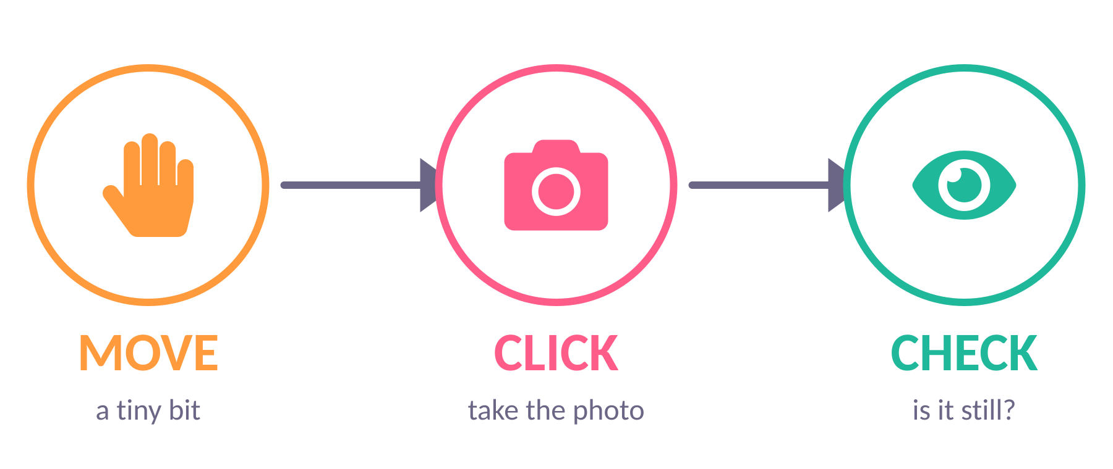
Move – Click – Check
Chant: “Move a little, click, click!”
Notes:
Teach the chant with actions. Quick check: What does the Mover do right before the click? (Takes their hands away.)

Slide 8
Plan your story
Year 1: 3 boxes
1
2
3
Draw a picture in each box
Start
Middle
End
What happens first? Then? How does it end?
Keep the story small and clear.
Year 2: 6 boxes
1
2
3
4
5
6
Notes:
8 min. Y1: talk through start, middle, end (e.g. a pencil slides across the desk and meets a rubber, or a drawing grows: seed, stem, flower) and draw 3 boxes. Y2: plan a story with a problem and a solution in 6 boxes.

Slide 9





Pick a story idea
A pencil race
A drawing grows on the whiteboard
A plant grows up
My name appears, letter by letter
A rubber goes on a journey
Build a stationery tower
Notes:
Pupils pick a story idea or make up their own. Everything comes from the classroom: small whiteboard and marker, pencil case items, paper cut-outs.

Slide 10
Make time!
Year 1
Year 2
10–15
20–30
photos
photos, following your storyboard
Is the tablet still? Are your hands out of the picture? Was the move tiny?
Notes:
20 min. Timer on screen; swap roles every 5 frames. Circulate with the three questions. Most common problem: moves that are too big, so remind pupils: smaller than that.

Slide 11



Show and tell
What worked well?
What was tricky?
Next time we will fix it and hold a film premiere!
Notes:
7 min. Pupils watch each other’s first playback. Save projects and tidy props. Check tablets are on charge.

Slide 12

Lesson 2: Edit, Premiere, Applause!
Stop motion = lots of photos played fast
Move a tiny bit, then click
Director, Mover, Camera
Let’s remember Lesson 1
Notes:
5 min. Replay a project from last lesson. Ask what the three jobs are.

Slide 13


Fix it!
Delete bad photos
Add a title
Change the speed
Hand in the shot? Blurry? Delete it.
Take a title photo at the start.
Not too fast, not too slow.
Notes:
8 min. Demonstrate each fix on the tablet. In the Stop Motion Studio app, tap a frame to delete it; use the speed setting for playback. Check the exact buttons on your own tablet before the lesson.

Slide 14


Slow or fast?
Slow
Fast
You can see every move. Good for careful stories.
Smooth and quick. Good for chases and races.
Improve time (17 min): fix it, add more photos, make it better!
Notes:
Groups improve their films: delete bad frames, add more frames where it jumps, add a title, choose a speed. Y2 can also check the film against their storyboard.

Slide 15


Film Premiere!
Quiet eyes while the film plays
Kind comments only
Wait until the end to clap
Notes:
15 min including feedback. Each group shows their film to the class (or tours the tablets). Rotate or project to the screen.

Slide 16


Two stars and a wish
Star 1
Star 2
Wish
Something I liked
Something I liked
One thing to make better
Say: “I liked… I wish…”
Notes:
Pupils give two stars (things they liked) and one wish (a kind idea) to another group. Y1 can use faces/stars on the pupil sheet; Y2 writes a short line.

Slide 17
I can…
I can take lots of photos with a tablet
I can say a film is made of lots of pictures
I can work with a partner and take turns
I can say what I like about a film
Notes:
5 min. Pupils show thumbs up, sideways or down for each statement. Year 2 can add: I can plan with a storyboard.

